Slide 1

POULTRY SCIENCE:
Commercial Layers
Unit 13

Slide 2
Poultry Science:
Commercial Layers
Unit 13: Segment 1
Chick & Pullet Management

Slide 3
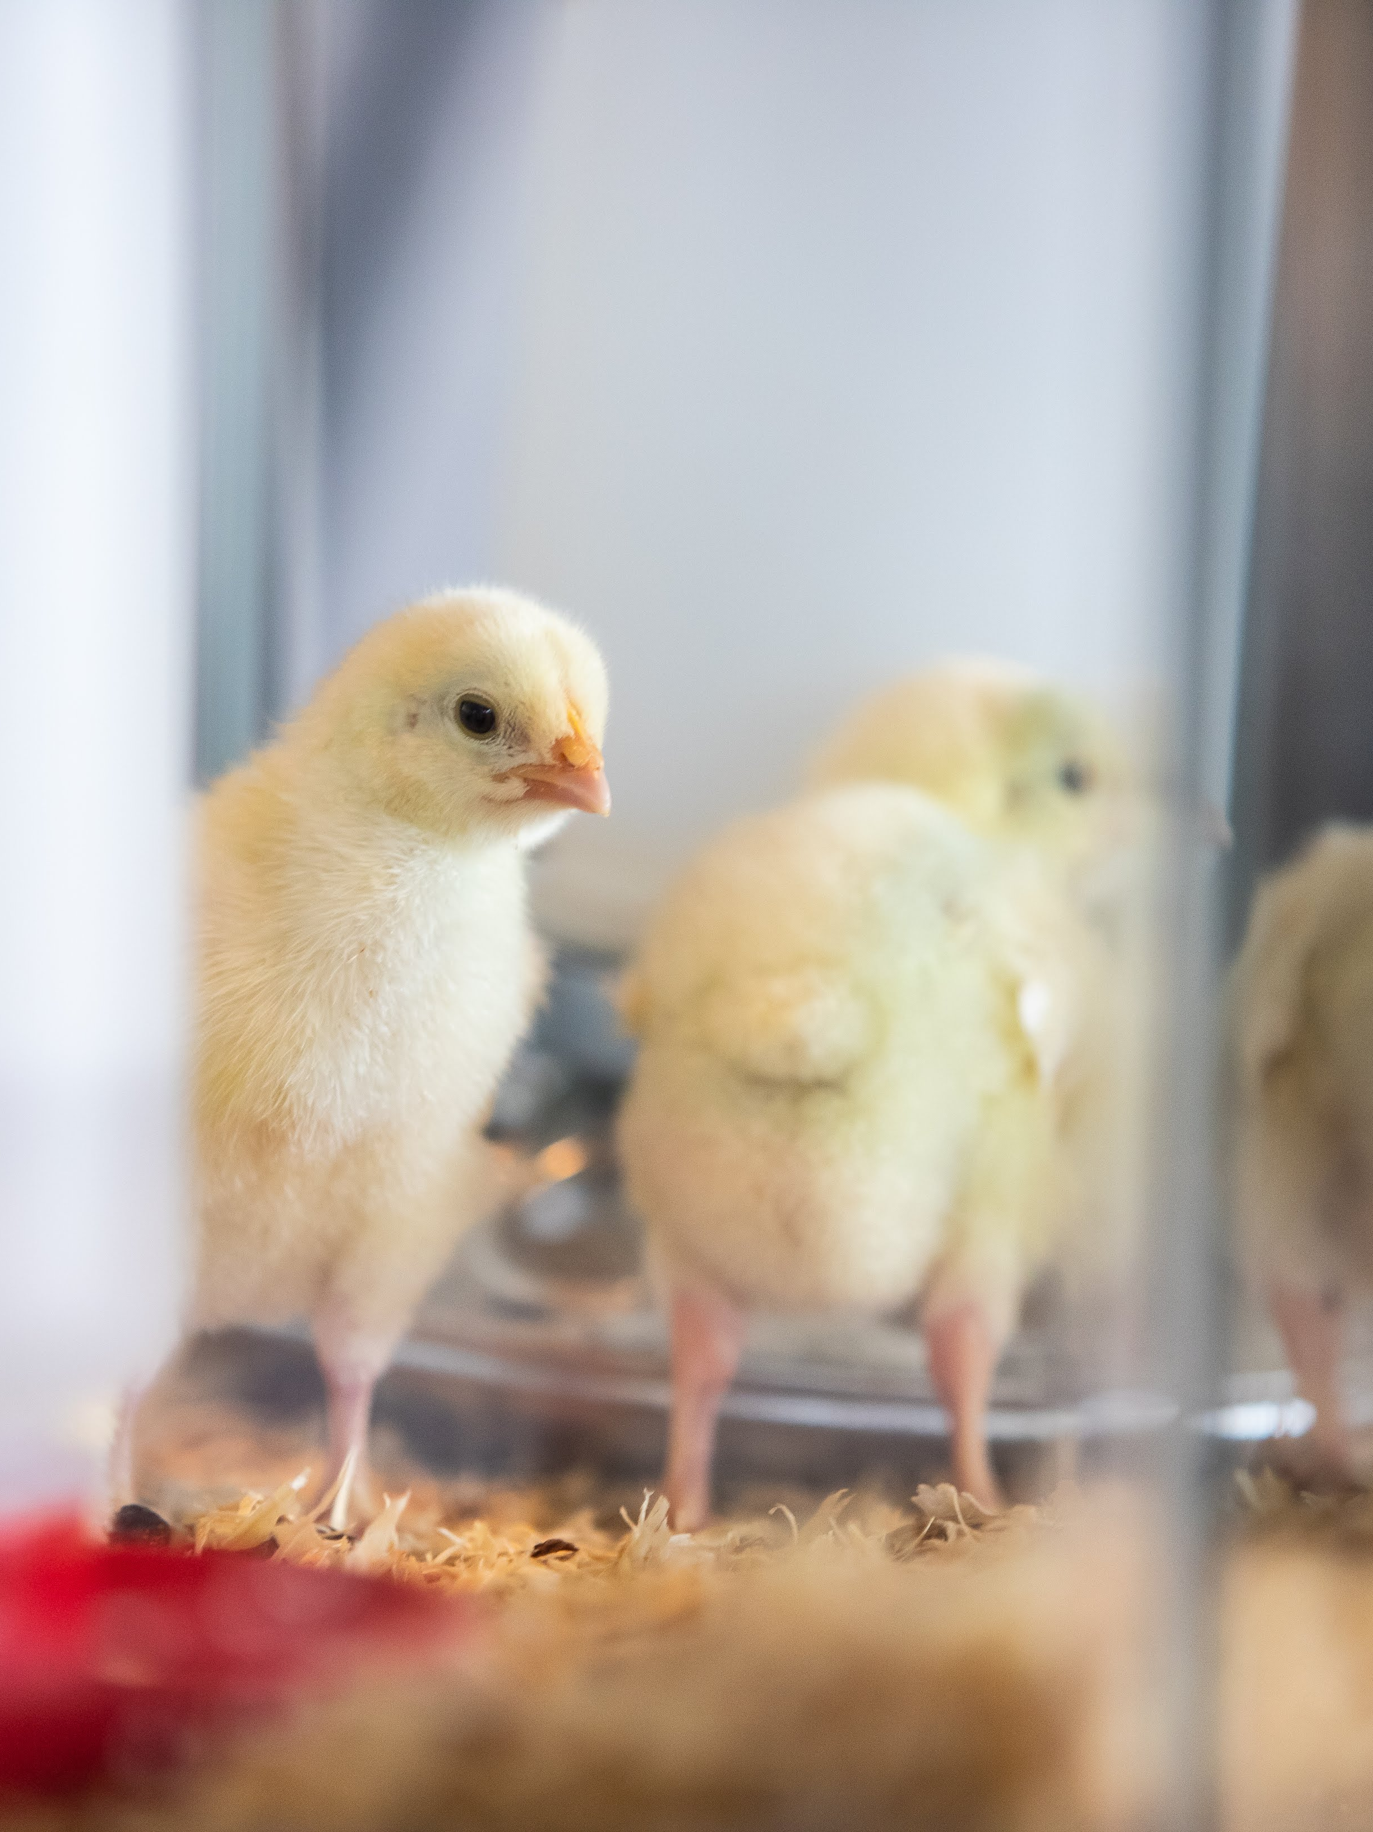
Chick Management
Layers typically have a long distance to travel at one day of age due to hatchery placement, leaving them more dehydrated and stressed, so it’s important to:
  Have visible water source with a water drop on the end of the nipple
  Feed placed near the water, and have the feeders filled up high
Loud peeping is a distress call (usually disturbed or cold)
Chicks will imprint, follow, and imitate other chicks and do as they do

Slide 4
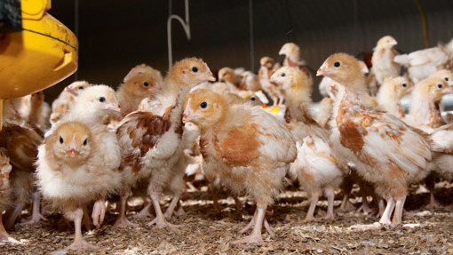
Pullet Management
When raising the pullets, it is vital to keep flock uniformity in mind.
Uniformity - % of flock within +/-10% of average body weight
Flock uniformity should be above 80% at least (90%+ preferred)
Flock uniformity is reduced by:
  Overcrowding
  Overheating
  Poor ventilation
  Poor nutrition
  Poor beak trimming
  Uneven thermal environment

Slide 5

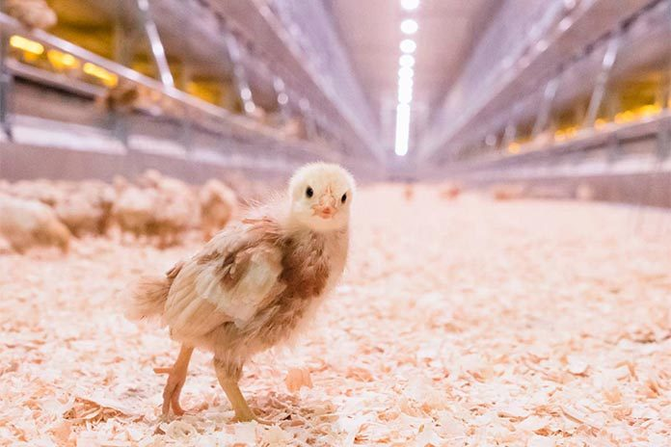
Pullet Management
Layer pullets do not have a large appetite, and stress can cause them to stop eating altogether.
Cannibalism and feather-picking are not good
  Cannibalism causes significant mortality but can be controlled with:
    Light intensity reduction
    Beak trimming

Slide 6
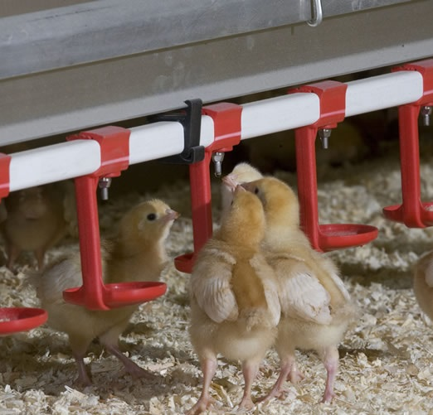
Pullet Management
Light is fundamental to the growth and development of pullets!
Three aspects of light need to be understood:
  Wavelength (color)
    Do NOT use red light for pullets!
  Intensity (brightness)
  Photoperiod (length of the daylight period)
Lighting should be uniform throughout the house
Long photoperiods are used at first to encourage eating and drinking
  20-23 hours of light

Slide 7
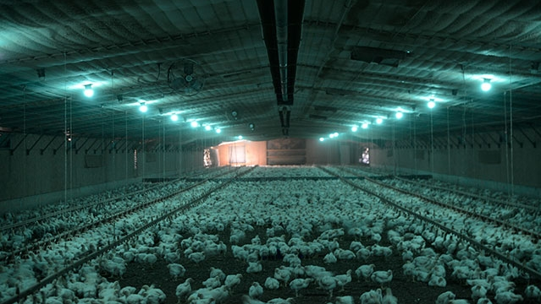
Pullet Management
Light Intensity Reduction:
Reduces stimulus
Reduces overall activity
These are particularly helpful regarding beak-related damage.

Slide 8
Poultry Science:
Commercial Layers
Unit 13: Segment 2
Layer Management

Slide 9
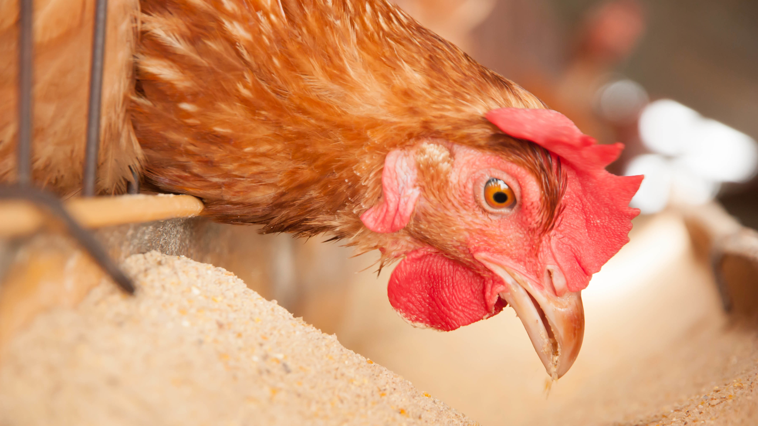
Layer Management
Photostimulation should begin when the comb begins to “bloom”
Move to 14 hours of light and 10 hours of darkness
Layers need a broad spectrum of light wavelengths
  Blue & green support growth
  Red & orange support egg production

Slide 10
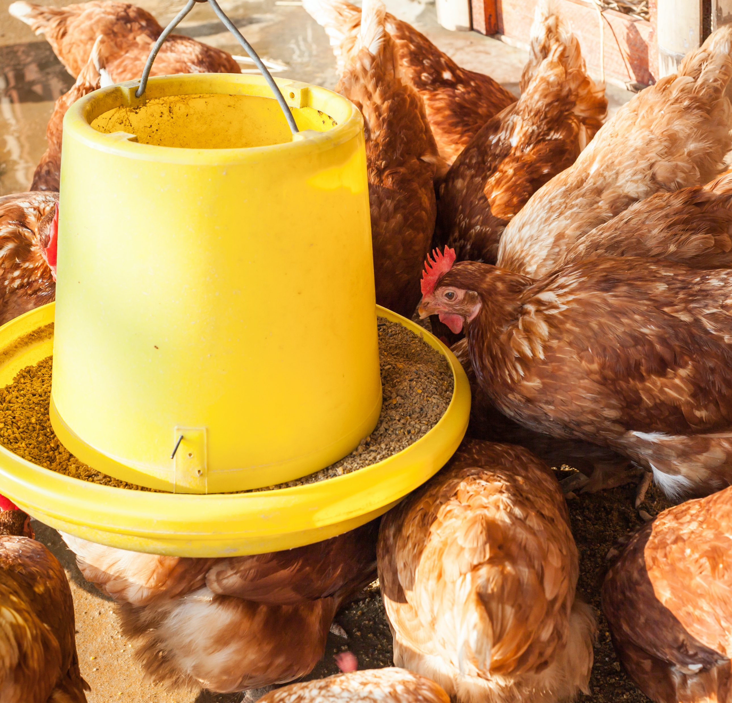
Layer Management
Birds need to sexually mature in order to begin producing eggs. Sexual maturation is influenced by:
  Body weight
  Age
  Lighting program
Later-maturing and larger pullets tend to lay larger but fewer eggs
  Body weight and lighting selection is based on production goals!

Slide 11
Layer Management
The amount of food the hen eats is in accordance to their energy requirements
Layer feed formulation revolves around this concept
Calcium metabolism is influenced by egg production, phosphorus metabolism, and vitamin D₃ metabolism
  Calcium absorption from digestive tract declines with age, so hens need a certain amount of calcium per day
  3.9-4.4% calcium depending on age
  One egg has 2g of calcium…approximately 10% of the hen’s skeleton!

Slide 12
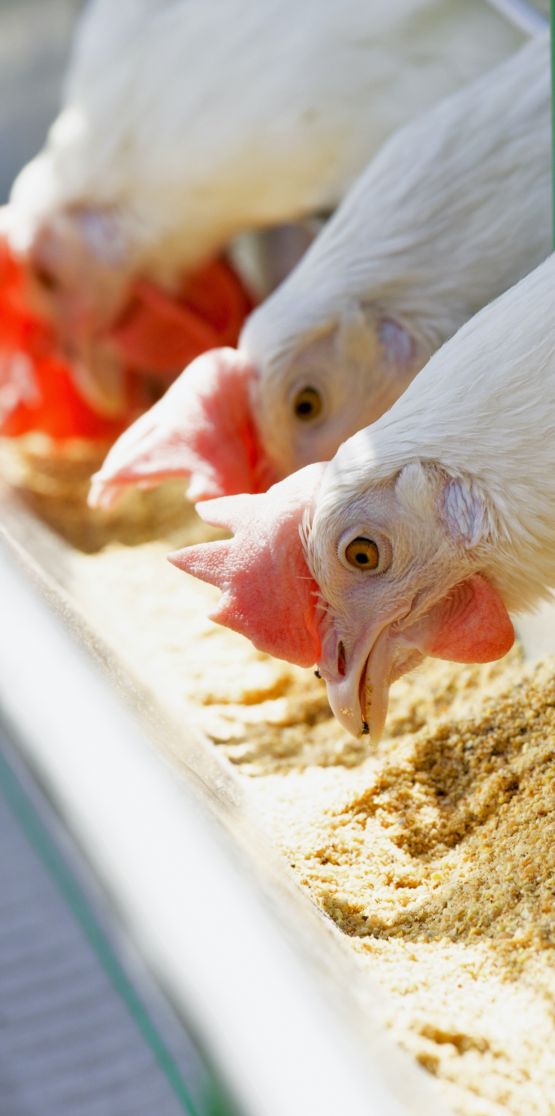
Layer Management
Medullary Bone – located inside the axial and limb bones, the medullary bone stores calcium and releases when eggshell is formed.
Structural bones will decalcify to support medullary bone, leading to Osteoporosis/cage layer fatigue.
Therefore, producers increase calcium 2 weeks before the 1st egg
Pre-lay calcium = 2.5-3%

Slide 13

Layer Management
If egg size is too small:
Reduce house temperature to increase nutrient consumption
Increase nutrient density of diet
If egg size is too big:
Increase house temperature
Dilute diet

Slide 14
Poultry Science:
Commercial Layers
Unit 13: Segment 3
Commercial Layer Housing

Slide 15
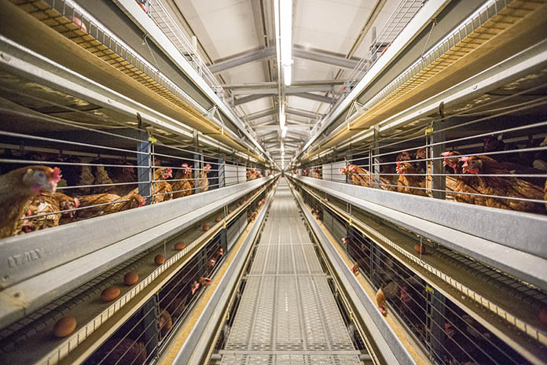
Housing for Commercial Layers
In today's egg laying facilities, temperature, humidity and light are all controlled, and the air is kept circulated.
The building is well insulated, windowless (to aid light control) and is force-ventilated.
Birds are either given the run of the floor area or are housed in cages.

Slide 16
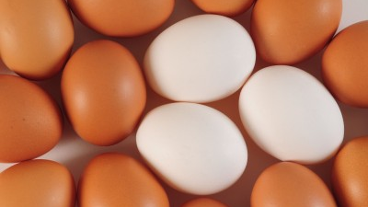
Housing for Commercial Layers
Temperature:
67-77ºF or even as high as roughly 87ºF
Humidity:
A relative humidity between 40-60% is best

Slide 17
Housing for Commercial Layers
Lighting:
Of primary importance both during the growing and laying periods, controlled, low-intensity light can be used to delay sexual maturity until the bird's body is big enough to produce larger eggs.
Today's laying hen doesn't need to depend upon the fickle sun to tell her when laying time has arrived.
Intensity and duration of light can be adjusted to regulate production.

Slide 18
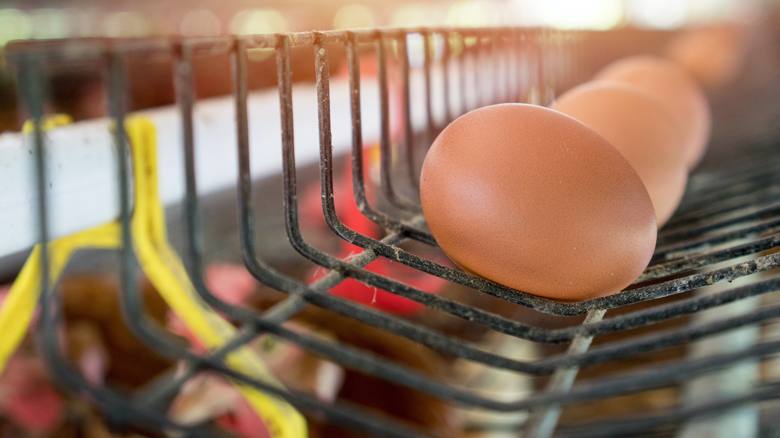
Housing for
Commercial Layers
Cages divide the population from each other in an effort to:
  Minimize adverse effects of hysteria
  Eliminate piling
  Separate hens from manure
  Impose behavioral constraints
Cages in a fixed location make the site of egg laying predictable and minimize labor in egg collection in addition to eliminating the issue of floor laying.

Slide 19
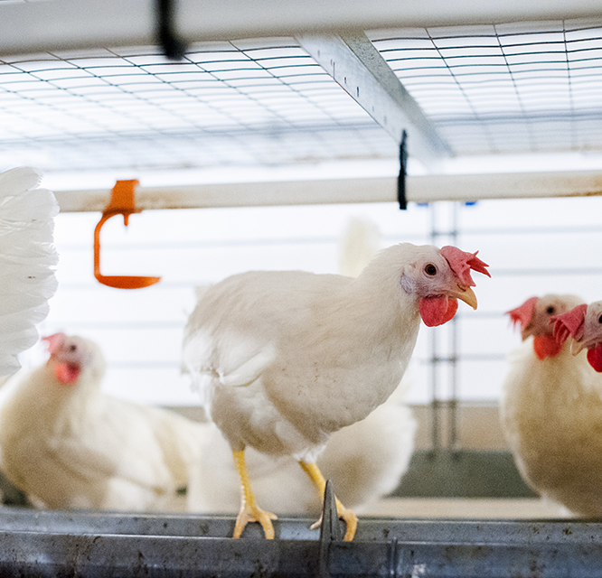
Housing for Commercial Layers
Enriched cages:
More space per bird
Nesting area
Perches
Scratch/dust bathing ability

Slide 20
Poultry Science:
Commercial Layers
Unit 13: Segment 4
Commercial Table Egg Processing

Slide 21
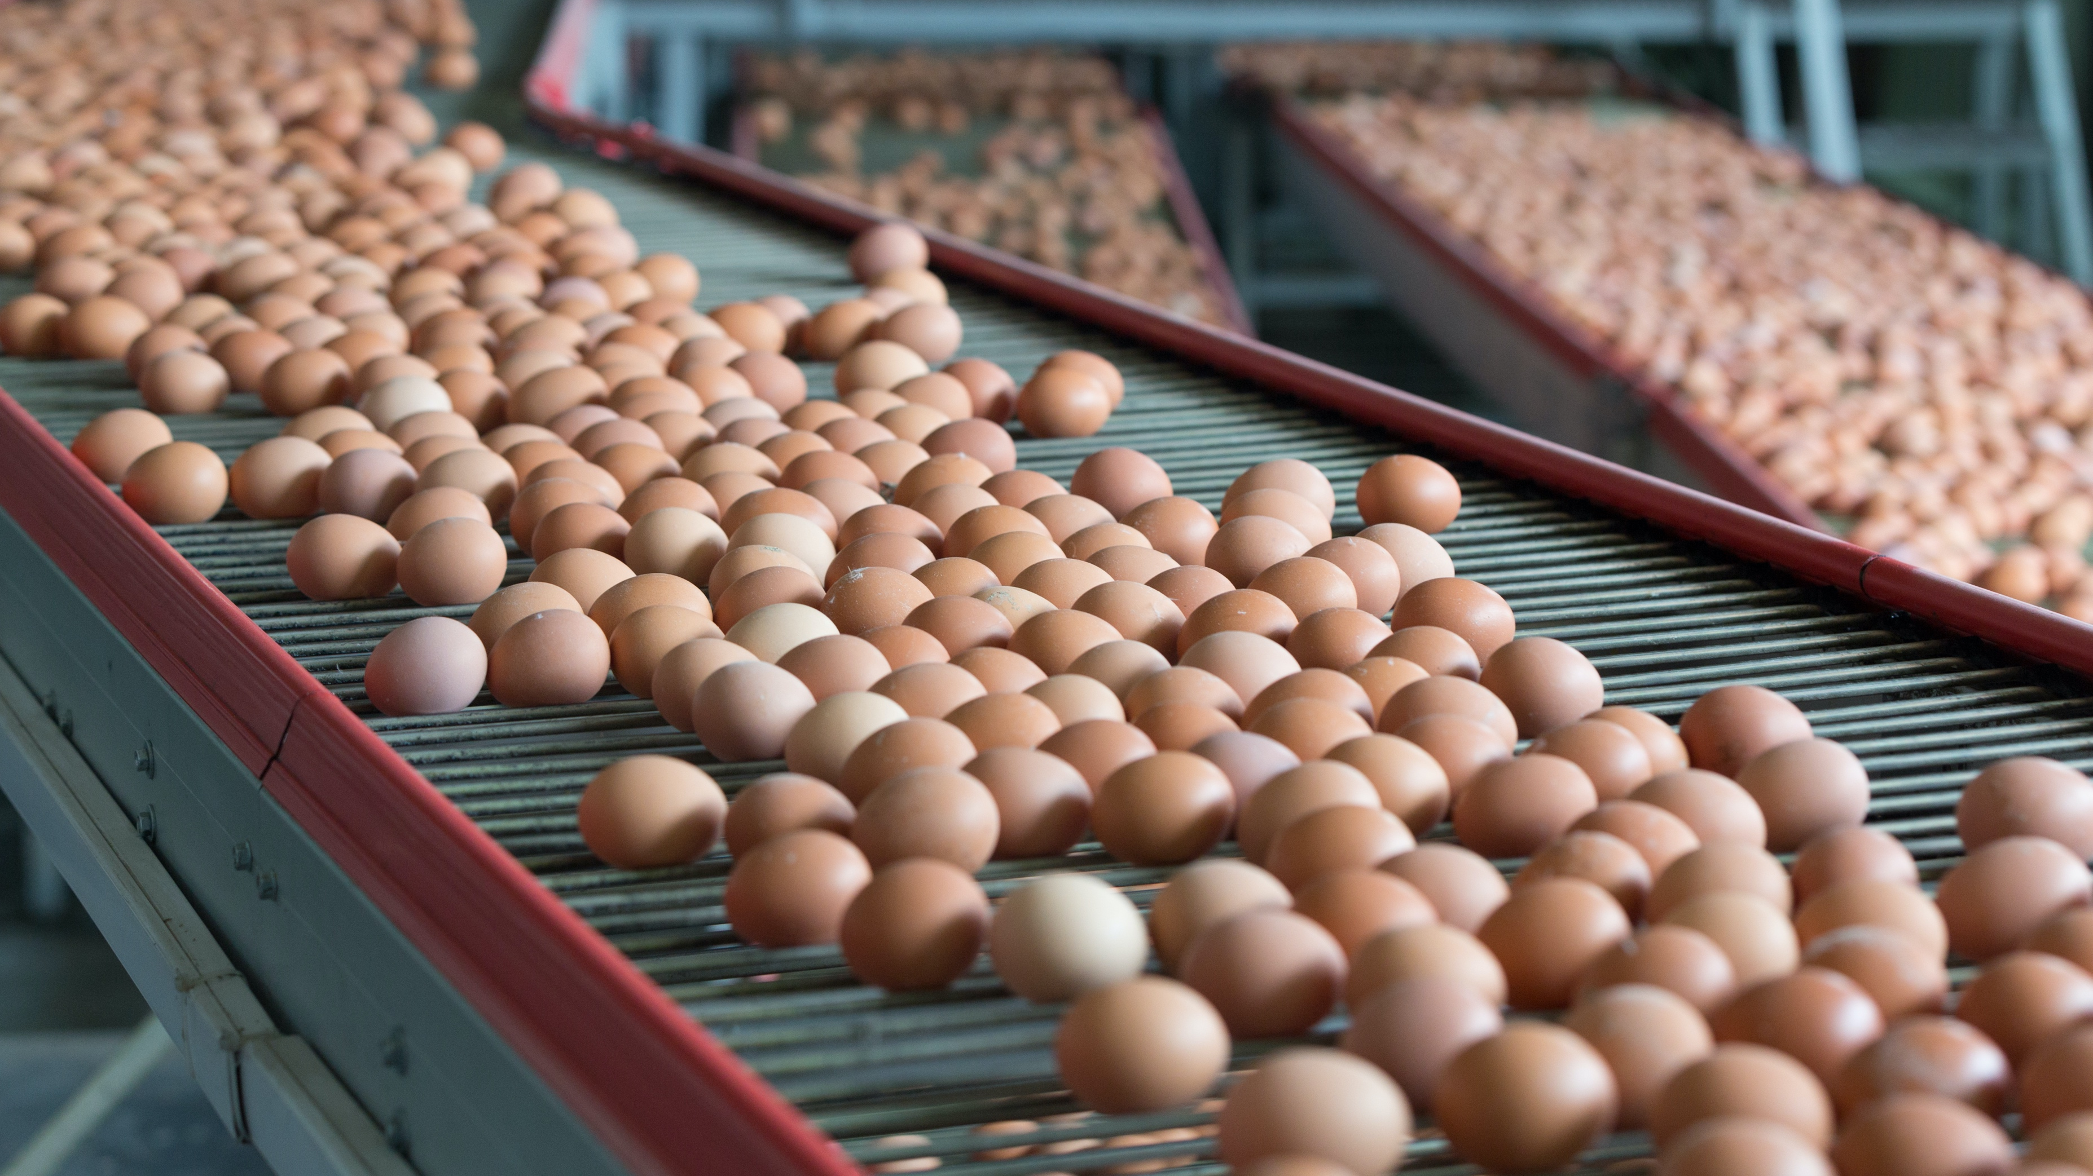
Commercial Table Egg Processing
Egg Processing Steps:
Collection
Washing
Sanitizing (UV)
Candling (looking for interior defects, shell defects, and leaks)
Dirt detection
Check detection (cracked, body checks, cage marks, etc.)
Weighing
Packaging
USDA verification
Cooling
Ship to store

Slide 22
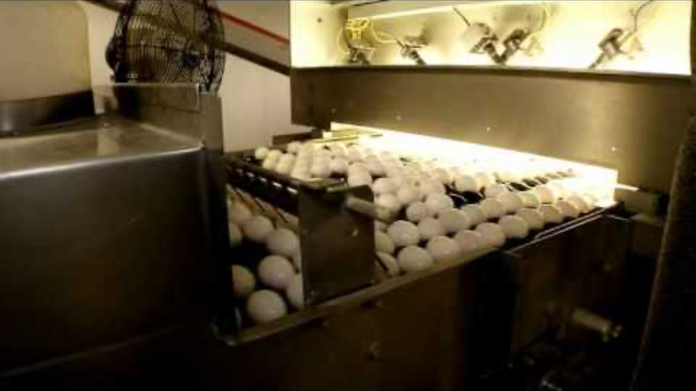

Slide 23
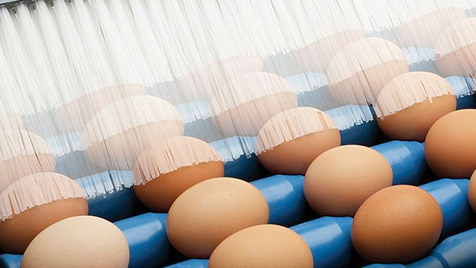
Commercial Table
Egg Processing
Wash Water:
Must be at least 90ºF
  100-114ºF is commonly used
  At least 20ºF higher than egg temperature
If eggs are warmer than the wash water:
Contraction of egg contents will draw water into the eggs, leading to contamination risk
Internal egg temperature can rise 8-12ºF during wash process

Slide 24
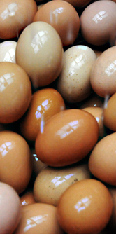
Commercial Table
Egg Processing
Eggs are washed with:
Spray jets
Brushes
Warm detergent solution
Water must be replaced every 4 hours and at the end of every shift!

Slide 25
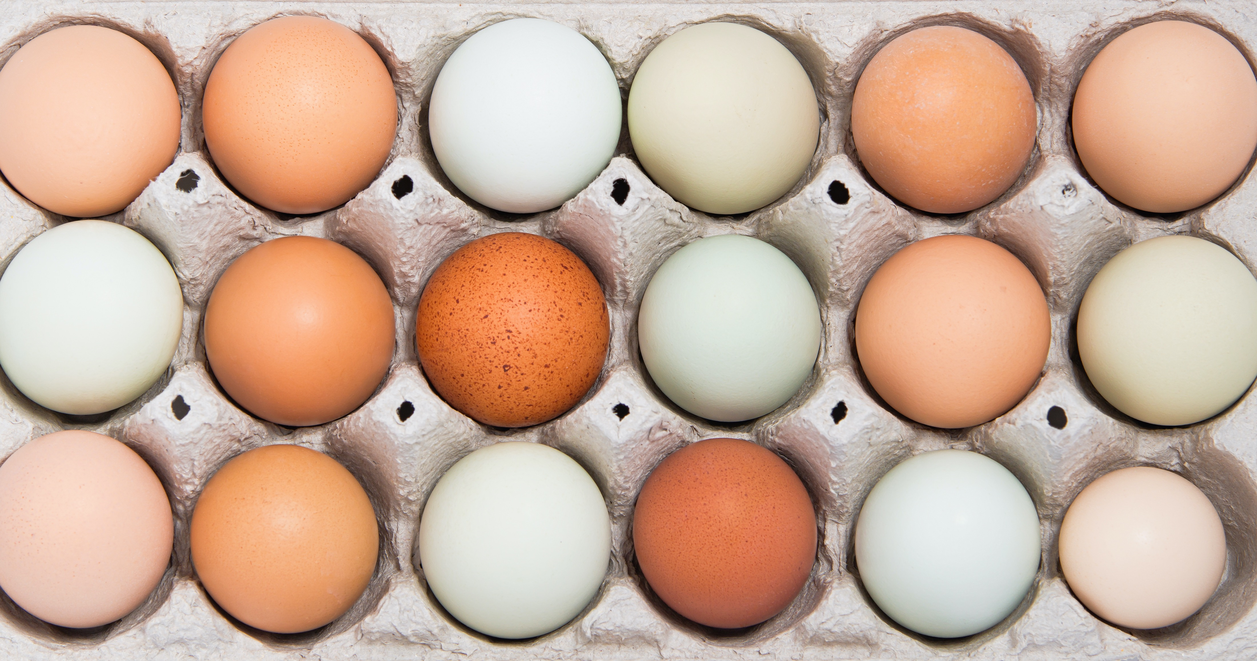
Commercial Table Egg Processing
USDA Egg Weighing & Classification Standards:
Peewee: < or = to 17.9 oz.
Small: 18.0-20.9 oz.
Medium: 21.0-23.9 oz.
Large: 24.0-26.9 oz.
Extra Large: 27.0-29.9 oz.
Jumbo: > or = to 30.0 oz.

Slide 26
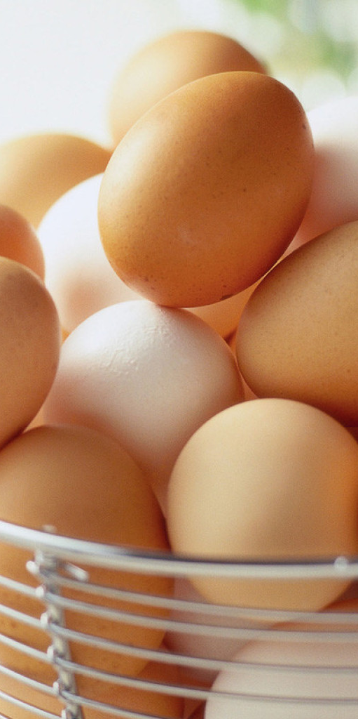
Commercial Table
Egg Processing
Case of Eggs = 30 dozen (47 lbs. per case)
USDA allows 7% cracks, but NO leakers!
Storage temperature:
45ºF within 36 hours of being laid
Forced air cooling system in vented/patterned cases

Slide 27
Poultry Science
Curriculum References
Jessica Fife, UGA Dept. of Poultry Science Outreach Coordinator, UGA Dept. of Agricultural Leadership, Education, & Communication MAEE Candidate
Barry Croom, UGA Dept. of Agricultural Leadership, Education, & Communication Professor
Ashley Yopp, UGA Dept. of Agricultural Leadership, Education, & Communication Assistant Professor
Georgia Agriculture Education
Andrew Benson, UGA Dept. of Poultry Science Assistant Professor
Brian Jordan, UGA Dept. of Poultry Science Assistant Professor, UGA College of Veterinary Medicine Assistant Professor
University of Arkansas Bumpers College of Poultry Science – Poultry Science Dual Curriculum Course
Julia Gaskin, UGA Dept. of Crop and Soil Sciences Sr. Public Service Associate
Glendon Harris, UGA Dept. of Crop and Soil Sciences Professor & Extension Agronomist
Brian Kiepper, UGA Dept. of Poultry Science Associate Professor
Claudia Dunkley, UGA Dept. of Poultry Science Public Service Associate
Casey Ritz, UGA Dept. of Poultry Science Professor
USPOULTRY & USPOULTRY Poultry Science Curriculum
Tom Tabler, Mississippi State University Department of Poultry Science Extension Professor
Jacquie Jacob, University of Kentucky
Jeanna Wilson, UGA Dept. of Poultry Science Professor
Kelly Sweeney, UGA Dept. of Poultry Science Ph.D Candidate
Merck Veterinary Manual
University of Maryland Extension
Poultry Hub
Brian Fairchild, University of Georgia Department of Poultry Science Professor
Centers for Disease Control
National FFA Organization

